Slide 1
How to Avoid the Common Pitfalls of Building Assessment Certificate Applications
Tim Galloway
Health & Safety Executive (HSE)

Slide 2
Avoiding common pitfalls
TPI Conference 2024
Tim Galloway
Deputy Director Regime Development and Regulatory Support at the Building Safety Regulator

Slide 3
Content
What is a BAC?
Some basics around Safety case reports and other documents that form part of an application
Pointers to help everyone: Principal Accountable Persons and BSR
Some Bear Traps to avoid
Some remarks about the Grenfell Report
Other things not to forget
Conclusions

Slide 4
Building Assessment Certificate (BAC)
BAC demonstrates that BSR is satisfied that certain legal duties have been met (at that time)
Principal Accountable Persons are directed by BSR to apply for BAC for their building(s)
Five-year programme of BAC assessments – allocated by height and number of dwellings
Year One – highest buildings with most dwellings, plus all ACM and LPS with gas
Applications required to include
Latest Safety Case Report
The Residents’ Engagement Strategy
The Mandatory Occurrence System
A statement confirming Accountable Persons have provided information to certain bodies (e.g. BSR, FRS, other Accountable Persons etc.)

Slide 5
Safety Case and Safety Case Report
The safety case sets out how you manage the risks of spread of fire and structural failure (aka building safety risks)
The safety case report:​
Summarises the information you have on your building​
Provides a demonstration that you have taken all reasonable steps to prevent building safety risks and reduce their effect if they occur​
Describes the arrangements in place for managing building safety risks​
Provides assurance to you and your organisation.

Slide 6
Some pointers
Make sure you have a Safety Case and a Safety Case Report – don’t wait until you are directed to apply for a Building Assessment Certificate
Make sure the Safety Case Report covers what the law requires
Demonstrate how you manage building safety risks, don’t simply make declarations
Sending every document that you have doesn’t provide assurance (in fact, the opposite)
Signpost: e.g. a Contents page that is consistent with the actual content (and that additional material/files are labelled consistently)
Make a proper assessment of the steps you have in place
Not about ‘getting your safety case report past the regulator’.
Risk Assessment: what ought we to be doing, what are we doing, is there a gap and what is our plan to bridge it?
Immediate, interim and long-term measures
May require physical alterations to your building.

Slide 7
If all is not well…
Failure to achieve a BAC does not necessarily mean the building is unsafe
BSR does not have the power to require a decant, but LAs and FRS have these powers
Compliance Notices can be issued by BSR where legal duties are not being met, e.g. reasonable steps are not in place
BSR is committed to being a proportionate regulator; minor matters might be resolved through a Prompt Remedy Notice
Some matters are likely to result in enforcement, e.g.: unremediated flammable cladding, LPS buildings with a gas supply which have not been reinforced post-Ronan Point.

Slide 8
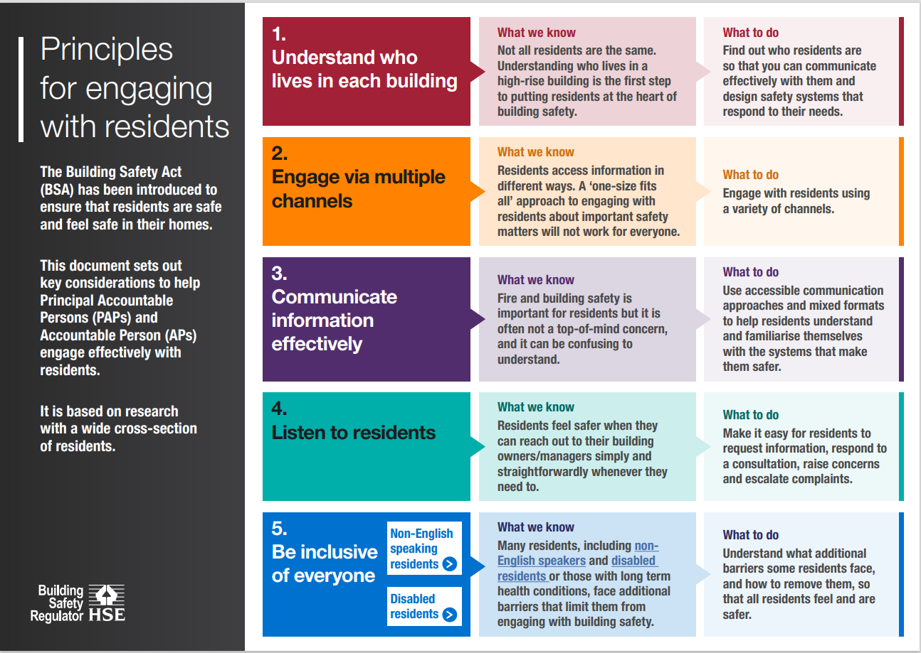
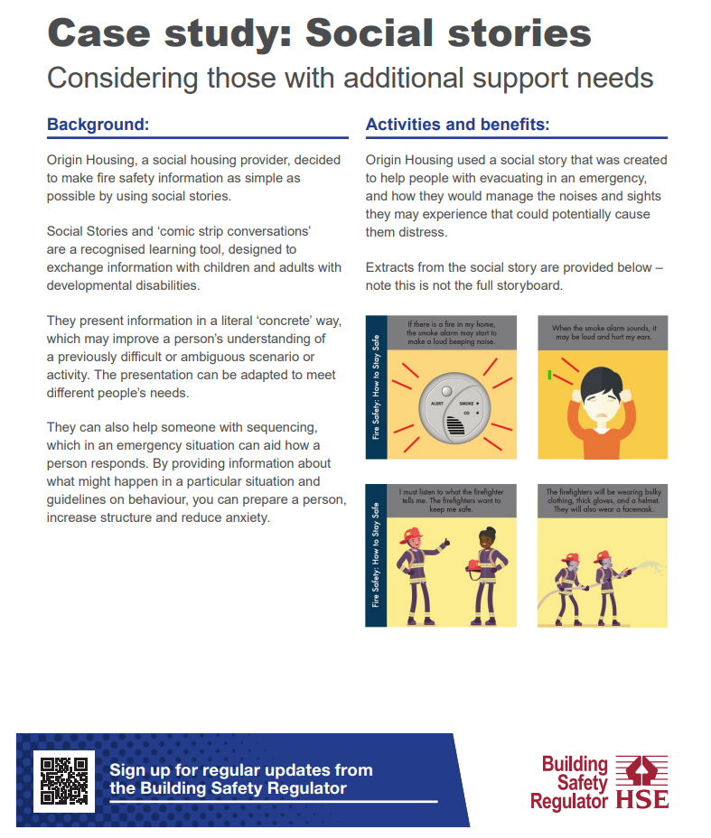
Residents’ Engagement Strategies
The RESs we have seen to date have been ‘aspirational’ or more about ‘telling’ than consulting or involving residents.
Your strategy needs to cover
The information you’ll provide residents with
What you’ll ask residents about
How you’ll collect and use opinions
How you’ll measure and review participation.
Notes:
I want to make some particular remarks on RES
The bullets are a direct lift from gov.uk guidance, but the panels are drawn from guidance on the buildingsafetycampaign microsite
Few remarks about listening to residents
1. Ensure residents can reach you Residents need to be able to get in touch with you in ways that suit them Create flexible, multichannel processes that allow residents to reach you via email, phone, face-to-face and online
2 Provide a visible, easy-to-navigate complaints process Residents need the complaints process to be transparent and clearly set out Provide step-by-step details of how a complaint will be handled and the timescales involved, with a named contact for residents to check the status of their complaint
3 Tailor responses to resident needs Residents frequently feel their complaints are neither heard nor taken seriously Keep residents informed of the progress of their complaint via their preferred communications channel, and provide opportunities to discuss steps to help to resolve issues both individually and as a group of residents
4 Clarify your role Residents do not always understand who is responsible for the safety of their building Make clear what your role and responsibilities are for building safety, your commitment to residents and when residents should engage with BSR to escalate concerns
5 Signpost residents Residents have broader concerns than just fire and building safety Consider what happens to residents’ complaints which fall outside of APs’ remits and be prepared to signpost residents to appropriate agencies to support them with other concern

Slide 9
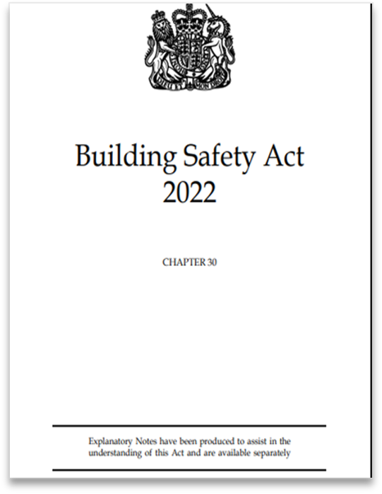
Other things not to forget
Duties on Clients, Principal Contractors, Principal Designers and other players in the supply chain
Implemented through regulations in 2023
These role titles are shared with those in CDM regulations but are legally separate ​
Focussed on planning, managing, monitoring and co-ordinating to make sure requirements of Building Regs are met
Apply to all building work in England (not just tall buildings)
Changes in building control processes for Higher Risk Buildings (HRBs)
Will affect works that might be required to implement reasonable steps
May affect works required to comply with other legislation, e.g. FSO
May affect works your residents want to undertake in their flats.

Slide 10
Grenfell Tower Inquiry Phase 2 Report
Published September 2024
Fourteen volumes, 1700 pages, 58 recommendations
Severe criticism of government, local authority and industry players
Stopped taking evidence in 2022 – not critical of new regime, but suggests more is needed
Government response within 6 months
Wider implications for industry
How might industry respond?
Gap analysis?
All organisations
Do you recognise the weaknesses outlined in the report in your organisation?
Gap analysis – what might your organisation need to do?

Slide 11
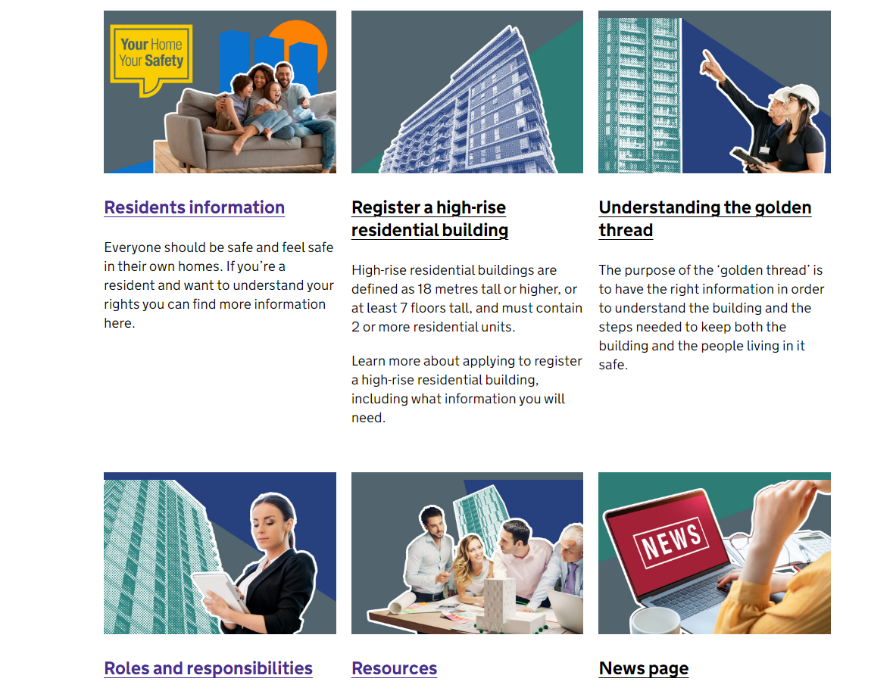
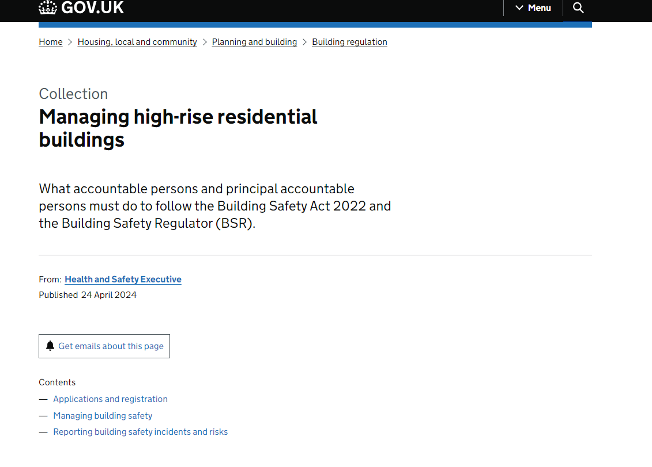
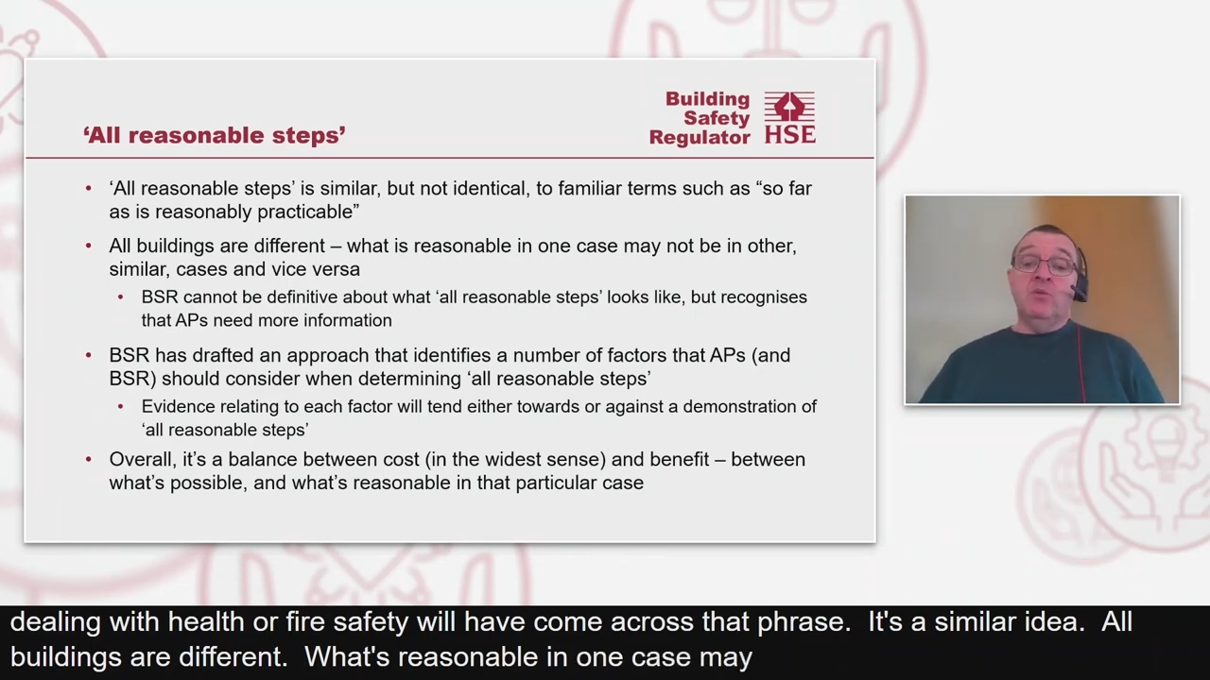
Resources
Building safety microsite www.buildingsafetycampaign.gov.uk
Guidance on gov.uk Managing high-rise residential buildings - GOV.UK
Webinar on BACs: https://www.youtube.com/watch?v=9OgmRE8mnII

Slide 12
Conclusions
The Safety Case Report provides assurance to you about your system for managing building safety risks
Residents’ Engagement Strategies and Mandatory Occurrence Reporting systems are also critical
Demonstrate to yourself that you are managing building safety risks, don’t simply declare
Demonstrate to BSR that you are managing these risks
Don’t forget the duties that apply to all building work in all buildings, not just HRBs
Grenfell Report – encourage you to undertake a gap analysis.

Slide 13
Any Questions?

