Slide 1
Lone Working Guidance for Property Managers
Breakout Session 2
Jodie Fraser, Fraser Allen Estate Management
Synergy
Breakout Room

Slide 2

Lone Working Guidance for Property Managers
Jodie Fraser BA(Hons) FTPI AssocRICS FIoL
CEO Fraser Allen Estate Management
Chair of Trustees for The Hollie Gazzard Trust
TPI Wellbeing Working Group Member
Mental Health First Aider
Podcaster (Beyond Four Walls)

Slide 3
Aims:
to understand what a lone worker is
to understand the risks lone workers face
to identify ways in which they can be supported
to understand how Hollie Guard can help keep lone workers safe
Lone Working

Slide 4
It is estimated that up to 8 million people in the United Kingdom are lone workers. That's 22% of the 31.2m UK working population. The NHS alone employs up to 100,000 healthcare professionals (9% of its workforce) who work on their own every day.
During the pandemic an unprecedented number of workers became lone workers, and many have continued to work solely from home or in a hybrid situation.
Lone Working – What’s the issue
Notes:
Employers are responsible for lone worker safety during working hours, whether they are in the office, in a vehicle, or on a home visit.
Establishing a healthy and safe working environment for lone workers can be different from organising the health and safety of other employees.
They should not be put at more risk than other people working for you.
Added Complexities working from home. Who else is present? Sensitive material around children – what might they hear? Still responsible for risk assessment of environment. Laptop on lap/in bed – H+S issue so HS lead should be checking on this. Is there any Domestic Abuse/concern – codeword for staff member to use should they feel unsafe or can’t talk.

Slide 5
While the Office for National Statistics doesn’t have a definition for “lone worker”, the Health and Safety Executive (HSE) defines lone workers as anyone who “works by themselves without close or direct supervision”.
For example:
Someone working alone in retail, a petrol station or shop (e.g. betting shop)
Someone working alone outside normal working hours such as cleaners
Service workers such as your postman/postwoman
Any situation in which someone works without a colleague nearby or when someone is working out of sight or earshot of another colleague (NHS Protect 2015)
If you work from home one day a week, you’re a lone worker (one day a week.)
Who is a Lone worker
Notes:
The Health and Safety Executive (HSE) defines lone workers as people who work by themselves without close or direct supervision.

Slide 6
The Health and Safety Executive (HSE) website highlights various risks without specifically quantifying them:
Stress and mental health
Accidents, particularly on the road
Violence, abuse and harassment
Risk to Lone Workers
Notes:
Outline risks to lone workers – note that these can be from external influences (public) as well as risks of falling ill at home alone.

Slide 7
There are between 123 and 205 assaults every day on lone workers.
That's between 44,850 and 74,750 attacks each year.
Instances of verbal abuse vary between 159 and 266 daily.
30% of domestic homicides take place in the workplace
https://www.urbanfitandfearless.com
Statistics

Slide 8
While there are no specific laws that govern lone workers, several pieces of legislation relate to their general safety:
Health and Safety at Work Act 1974
Management of Health and Safety at Work Regulations 1999
Corporate Manslaughter Act 2007.
Failure to comply with legislation by protecting your employees can lead to large legal costs, fines, loss of reputation and even prosecution, imprisonment or folding of the business.
ACTION: Employers assess risk and take steps to control.
Responsibilities – Employers
Notes:
By law, employers have specific responsibilities towards the safety of their employees, as do the employees themselves.

Slide 9
What you must do
Like any worker, you must take care of your own health and safety and that of others who may be harmed by your actions at work.
You must cooperate with your employers and other workers to help everyone meet their duties under the law.
How to raise any concerns
If you're concerned about health and safety risks to you as a lone worker, talk to:
your employer
a manager or supervisor
a health and safety representative
Responsibilities - Employees
Notes:
Employees
All employees have responsibilities to take reasonable care of themselves and other people affected by their work activities as well as to co-operate with their employers in meeting their legal obligations.
Precedent: Lone working policy sets out some specific responsibilities for both employers and employees in terms of lone working. If you need hep with this we can help.

Slide 10
Hazard – A physical thing that causes harm
Risk – the likeliness of somebody being harmed by one of the hazards
5 Point Plan
Identify – Any possible hazards
Consider – which staff may be harmed
Evaluate – if existing precautions are adequate
Record – your findings and implement them
Review – on a regular basis
Identifying Risks
Notes:
Lone working is not against the law, however, the law does require you to carry out a risk assessment.
A separate lone working risk assessment is especially important because lone workers are often more vulnerable than someone who, for example, works in a busy office.
Risk or Hazard?
A hazard is a physical thing that causes harm. This could be dangerous chemicals, electricity or work at height. In the case of lone workers, it could be an intruder or the sudden onset of illness.
Risk is the likeliness of somebody being harmed by one of the hazards. Is there a low, medium or high chance? There should also be an indication of how serious the harm could be to an individual.
General Risk Assessments
The risk assessment process is not about creating huge amounts of paperwork; it is about identifying risks and taking proportionate measures to control them. A risk assessment doesn’t need to be carried out by a health and safety expert either. A confident manager or team leader can do the assessment.
The Health and Safety Executive (HSE) introduced a five-step approach to controlling risks in the workplace. Here’s a brief overview…
Identify any possible hazards by examining the nature of the job; the type of clients the employee may encounter; place, location and time; the views of the staff; and recent incident reports.
Consider Next, think about which staff employees might be harmed. What type of injury or ill health might occur?
Remember, given the nature of many public-facing lone working roles, violence, hostage taking or false imprisonment are all possible risks.
3. Evaluate You must decide whether the existing precautions are adequate or more should be done? Are risks low or acceptable? Are there systems in place to eliminate or reduce risk, and do you have clear risk assessments?
Do your staff have skills in defusing situations? Do you have a lone working policy in place? Find out if there is a clear audit trail to ensure colleagues know the whereabouts of an employee in the event of non-return. Finally, assess the suitability of existing personal safety devices.
4. Record your findings and implement them. Compile your research and complete the risk assessment. Design an action plan based on this information and communicate to all employees.
5. Review It is important to keep your action plan up to date. So, ensure to review the plan regularly (at least once a year), updating an implementing any changes.
You can find risk assessment examples on the HSE website, which you can use as a basis to create your own lone worker risk assessment.
Lone Working Risk Assessment
Assessing the risks that your lone workers face is an important step in complying with legislation, whilst demonstrating your duty of care. The HSE don’t provide an example that specifically deals with lone worker hazards, so you need to create your own.
The risk assessment is a key part of the lone worker picture. But to sufficiently protect employees, you need to be able to put together an actionable plan, a lone worker policy and provide specific training and communications.
We’ve put all of the information that you’ll need in a handy guide

Slide 11
Suitability – can the risks be suitably controlled by the lone worker
Stress – do the demands of the role place unnecessary stress on the employee
Health – asses the lone workers health
Environment – does the environment present special risks for the lone worker
Language Barriers – ensure there is clear instructions and advice that is understood
Violence – consider likelihood of threats or violence towards the lone worker
Special Groups – consider risks faced by certain groups e.g. trainees, young people etc
Risk Assessments – Check List
Notes:
1. Suitability
Check that the risks of the job can be suitably controlled by a lone worker? Some jobs/tasks just aren’t suitable for one person on their own.
Dangerous substances or machinery - Will the job require the lone worker to handle dangerous substances or machinery?
2. Stress
Stress is one of the biggest factors in employee absence. Might the demands of the role place unnecessary amounts of stress on the employee?
3. Health
Assess the lone worker’s health. Some medical conditions may pose too many risks. Take into consideration what would happen if the employee fell ill whilst working alone.
4. Environment
Consider whether the environment presents special risks for a lone worker. For example, working at height or in remote locations.
5. Language barriers
Make sure that any lone workers whose first language isn’t English have clear instructions and advice. Especially on what to do in an emergency.
6. Violence
Consider the likelihood of threats or violence towards the lone worker. More common in public facing roles but this still needs to be considered for all lone workers.
7. Special groups
Think about the particular risks certain groups of people may face, such as trainees, young, pregnant or disabled employees.
Some of the risks lone workers face are not all that different from what their non lone working colleagues may come across. The difference is in the outcome. For example, if an employee suddenly became ill at work, colleagues would be able to immediately assist by calling an ambulance or giving first aid. This would be entirely different for someone working alone, with a potentially much worse outcome. That’s why it is essential that you perform separate risk assessments for your lone working staff.
The actions you take as a result of the lone working risk assessment may call for additional supportive measures such as lone worker devices or training. Please get in touch for advice on either.
It will often be safe to work alone. However, the law requires employers to think about and deal with any health and safety risks before staff are allowed to do so.
The Management of Health and Safety at Work Regulations 1999 (MHSW 1999), SI 1999/3242 require all employers and the self-employed to assess the risks from their work on anyone who may be affected by their activities.
MHSW 1999, SI 1999/3242 require employers to carry out a systematic examination of their work activities and record the significant findings of their assessment. If you have five or more employees, you must record your findings in writing.
You have probably already considered what could go wrong in terms of health and safety generally in your business (see further: Health and safety assessment and planning—overview and Precedent: Health and safety risk assessment). Indeed you must look at all your work activities that have the potential to cause harm and decide whether you're doing enough to meet (at least) your legal obligations. But lone working can present a whole host of unique risks you must consider if you are to allow or require staff to work alone.
Your risk assessment will depend on your organisation and may vary depending on the nature of the work. However, your assessment must consider everyone who could be affected by lone working.
As well as employees, others who could be affected must also be considered. This might include contractors, temporary workers, volunteers and the general public.
Some groups are considered more vulnerable, such as:
young persons under 18, and
expectant and breast-feeding mums
Your risk assessment of lone working could take the form of:
small focus groups to discuss and explore potential risks
surveys or questionnaires
observing staff in their working environment
analysing any incident reports, and/or
a formal auditing process
You may wish to conduct specific lone working risk assessments each time a member of staff becomes a lone worker. You can use Precedent: Lone worker risk assessment for this purpose.
Your risk assessment should help you decide on the right level of supervision, and other controls, and you should then be in a position to craft your policy and procedures.
Risk assessment isn't a one-off task. You should review risk assessments periodically or when there has been a significant change in working practice. This may include:
being aware that some tasks may be too difficult or dangerous to be carried out by an unaccompanied worker
where a lone worker is working at another employer’s workplace, informing that other employer of the risks and the required control measures
when a risk assessment shows it is not possible for the work to be conducted safely by a lone worker, addressing that risk by making arrangements to provide help or back-up
If you have five or more employees, you must record significant findings of your risk assessment.
You may wish to consolidate your lone working risk assessment into your general health and safety risk assessment (see Precedent: Health and safety risk assessment), risk assess lone working on an individual case basis (see Precedent: Lone worker risk assessment), or both.

Slide 12
Financial cost of a serious incident
Staff turnover
Absence
Negative Impact from Failure to Comply
Notes:
Serious Incident Cost
If an employee’s personal safety is compromised and you have not provided ‘reasonably practicable’ protection, it can result in a large fine. In addition, the HSE (Health and Safety Executive) estimate that managing a serious incident can cost between £17,000 and £19,000.
Staff Turnover
Staff who suffer worrying situations at work are more likely to leave. According to the Chartered Institute of Personnel and Development (CIPD), the average cost of staff turnover per employee stands at £8,200. Relieve your lone workers of undue worry by protecting them and benefit from lower staff turnover.
Absence
Employee absence has huge financial implications. CIPD highlighted in their 2016 Absence Management Survey Report that stress is the most common cause of long-term absence and is the second most common cause of short-term absence. Stress free, happy employees are less likely to call in sick.

Slide 13
Things to consider/include:
The definition of ‘lone worker’
The purpose of the lone worker policy
The organisation’s approach to staff safety
Commitments of the employer
Manager’s responsibilities
Employee’s responsibilities
How and when to report an incident and what further action will be taken
What help and support is available
When the policy will be reviewed
Lone Working Policy
Notes:
Good practice to have one.
There is no legal requirement to have a lone worker policy. However, having a policy can help to promote a strong lone worker safety culture and provide guidance to staff and thereby reduce the risk of things going wrong.
Your policy could include: read slide
Some info may be in the employee handbook
We can help with templates

Slide 14
Information & training
Communication
Monitor & evaluate
Ongoing support
Implementing your policy
Notes:
Information & training
Education is vital for the protection of staff within the workplace to understand and mitigate risks that can occur. Training should focus on the avoidance of conflict and provide best practice for non-violent resolution. Training topics should cover:— Awareness of lone worker safety— Importance of policies and procedures set out for personal safety— Planning and preparation to reduce risk— Practical risk avoidance strategies— Communication skills including diffusion and de-escalation techniques— Good practice— Use of personal protective equipment e.g. safety devices— Ongoing communications in order to successfully implement a lone worker policy and create a safe working culture, management need to lead by example. This includes attending training sessions with staff and broadening their knowledge on personal safety and what systems are available in the market. It should also be noted that lone worker policies and systems will only work if people adhere to procedure and use the information provided. When policy and procedure are not followed, incidents are most likely to occur.
Communication
Communication is a process that is continuous and ongoing. Policy and advice should be regular and consistently distributed though your organisation. Ways to provide information include:— Staff meetings and discussions— Resources such as newsletters, magazines and videos— Staff intranet— Handbooks— Mentoring or buddy system
Monitor & evaluate
Monitoring is the regular and ongoing collection and recording of information in relation to current policies and guidelines. Evaluation is analysing the effectiveness of the information gained from this monitoring. By using this approach, lone worker policy can be improved through informed judgements. The types of data that need to be collected include:— The number and severity of incidents— Areas in which an incident has occurred— Time of day an incident has occurred— Staff feedback regarding their personal safety and existing LW systems— The number of staff who have attend safety training— The number of days lost due to absence— The cost of compensation and litigation— Increases in insurance premiums
Ongoing support
If an incident does occur, there are some immediate actions and long term activities which can be used to support employees: Info & Training04.Communication05.Monitor & Evaluate06.Ongoing Support07.There are no absolute restrictions on working alone, it depends on the findings of a risk assessment and the implementation of a robust policy. A risk assessment is an important step in protecting your lone workers — it helps you to focus on the risks that really matter, as well as complying with the law. Within 24 hours1–7 days7+ days— Provide medical assistance— Police attendance— Contact family/next of kin— Reporting on incident— Counselling if appropriate— Support from colleagues and management— Follow up with police/employer— Continued counselling if appropriate— Legal advice and support for the individual where necessary

Slide 15
Approach from four linked angles:
Prevention
Response
Training
Management and supervision
Establishing safe working practices to ensure employees can:
avoid dangerous situations
call for a response if needed, and
manage emergency situations if they do arise
Protection
Notes:
You can't protect your lone workers in any conventional sense—you can't physically be with them in an emergency. And indeed lone workers are especially open to risks which cannot always be managed. So you must go as far as you can to help them help themselves.
It's helpful to approach this from four linked angles:
prevention
response
training
management and supervision
Protection is about establishing safe working practices which, when combined with response arrangements, go a long way to ensuring that employees can:
avoid dangerous situations
call for a response if needed, and
manage emergency situations if they do arise
Prevention
Prevention is all about policies and procedures which result in lone workers and their managers being aware of potentially dangerous situations, avoiding them if possible and managing them if they cannot be avoided.
Prevention measures are likely to include instruction, communication and supervision.
Responding to an incident
You cannot eliminate all risks so you need to think about how you and the lone worker will respond effectively to an incident.
Lone workers should be capable of responding appropriately to an emergency and there should be emergency procedures in place with those workers. This might include providing workers with first aid facilities (see: First aid—overview).
Training
Underpinning all this is training. Lone workers need to be sufficiently experienced to fully understand the risks and precautions required and be competent to deal with unusual or new circumstances beyond their training, and know when to stop and seek advice.
Training should cover:
your policies and procedures for lone workers
awareness and how to avoid potentially dangerous situations, and
managing situations if they do arise
Training is particularly important where there is limited supervision.
Management and supervision
The extent of supervision depends on the risk and the ability of the lone worker to identify and handle health and safety issues.
A manager with responsibility for protecting lone workers should consider:
how will lone workers be encouraged always to follow your policies and procedures?
how will training be delivered?
what reports do you need and how will they be delivered?
how will you conduct reviews with your lone workers?

Slide 16
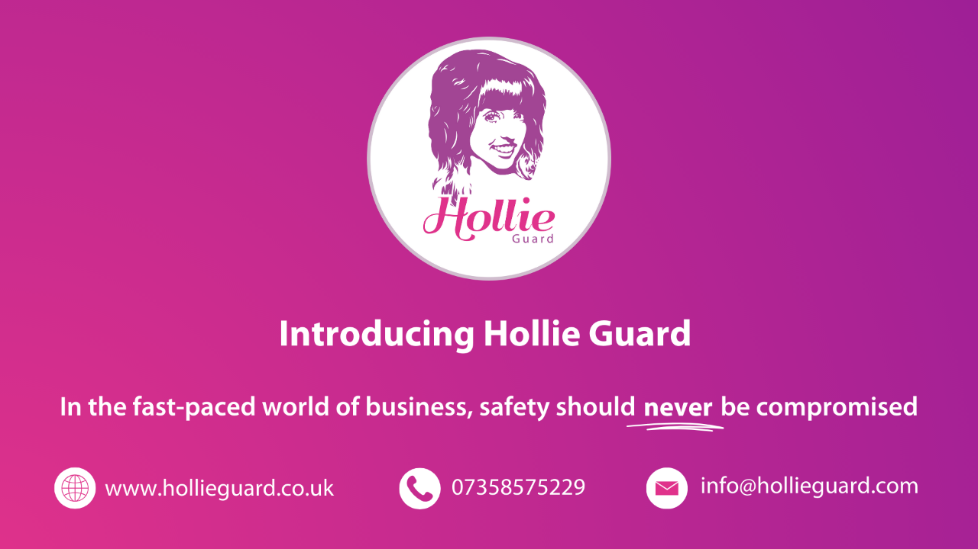
Notes:
Hollie Guard Introduction - Hollie Guard, named in honour of Hollie, is a mobile app designed to enhance personal safety and provide peace of mind. Through its modern interface, individuals can activate an array of features that alert their chosen contacts and authorities (in some cases) in the event of an emergency.
Hollie Guard currently has over half a million users and is recommended by numerous police forces and local authorities across the country to victims of domestic abuse and stalking due to its evidence-capturing capabilities. However, Hollie Guard can be used by anyone, of any age with personal safety in mind.
People commonly use Hollie Guard when simply commuting to and from school/college/work.
The app uses GPS, audio, and video functionalities to communicate distress quickly and effectively to the nominated emergency contacts, making it a reliable tool for anyone concerned about their safety – day or night.
Throughout this presentation, we will delve into the key features of the Hollie Guard app, exploring how it can be used in critical moments and be a proactive measure in preventing dangerous situations.

Slide 17

Hollie Gazzard
1993 - 2014
Notes:
Introduction to the trust, Hollie’s story and our aims.

Slide 18


Hollie Guard for Lone Workers
Lone workers face unique safety challenges on a day-to-day basis and there might not be immediate help in case of an emergency.
Hollie Guard can help protect workers wherever they are, at any time.
Suitable for various professions including healthcare, construction, and retail.
*Multiple subscription options available.

Slide 19
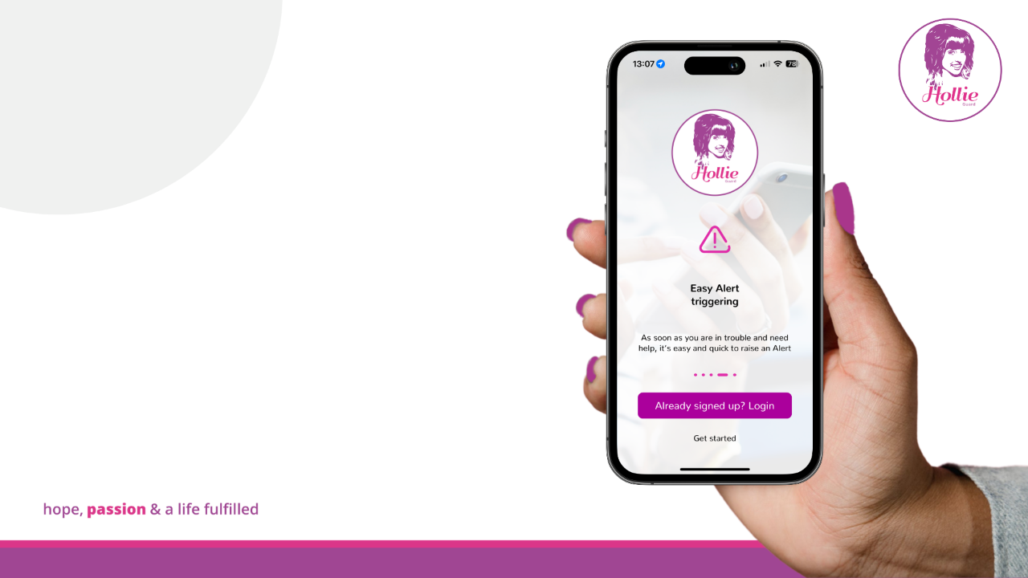
How to
Register
Hollie Guard works on various operating platforms, including Apple (iOS)- version 6.0 or higher & Android - Version 2.3 or higher.
Available to download anywhere within the UK.
Simple registration process which only takes a couple of minutes to complete.
Notes:
Registering - Registering for Hollie Guard is simple and only takes a couple of minutes to complete.
Go to your relevant Appstore and search for Hollie Guard.
Once downloaded, you will need to create your user profile by entering your personal details and creating a unique 4-digit PIN.

Slide 20
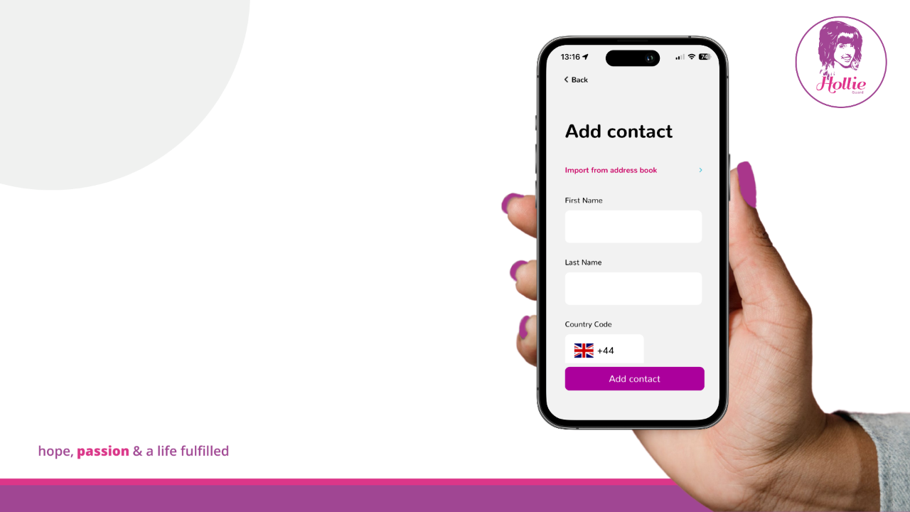
Emergency Contacts
Your emergency contacts are an important part of your Hollie Guard profile.
Adding emergency contacts gives you the peace of mind that your loved ones can check on you accordingly.
Your contacts will also be safe in the knowledge that they will receive a text message/email if you’re in danger.
Notes:
Emergency Contacts - Once registered, the next step will be to add emergency contacts.
Emergency contacts are a very important part of your user profile. These will be the people notified via text and email if you activate an alert.
We recommend checking with your loved ones before adding them to ensure that they’re happy to be nominated.

Slide 21
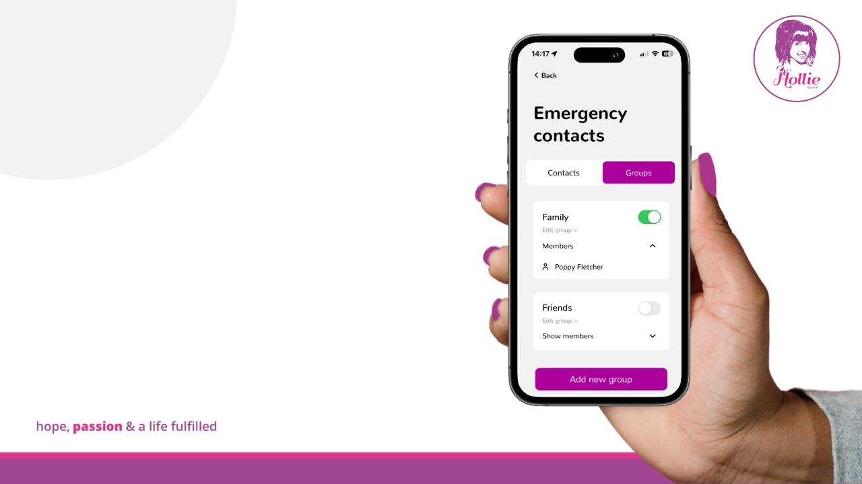
Grouping
Contacts
There are lots of benefits to setting up groups on your emergency contacts list.
You can turn off alerts for some groups and keep them on for others.
Some users create groups to differentiate individuals e.g. a group for colleagues and a group for family/friends.
Notes:
Group Emergency Contacts - There is no limit on the number of emergency contacts which can be added to your user profile. Therefore, if you nominate more than one emergency contact, it may be beneficial to group similar contacts together.
Sometimes, individuals have groups for family members, friends, and work colleagues.
You can select which groups are notified at certain times of the day by selecting the button to the right of the group. Green will indicate that the group is on and will receive any raised alerts.
Once you’ve added your emergency contacts, Hollie Guard will be ready to use when needed.

Slide 22
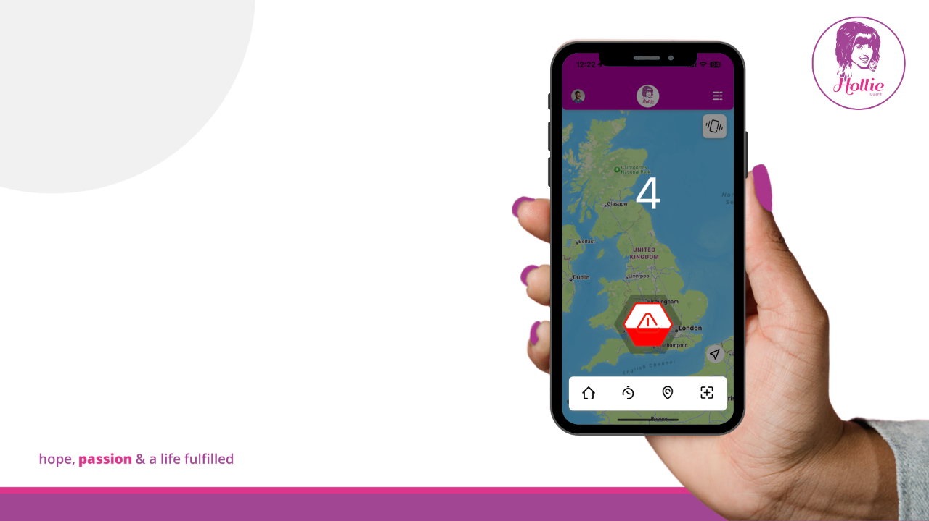
Raising an alert
The ability to activate an Alert is one of the key features of Hollie Guard.
Once an Alert is activated, your location and supporting video and audio evidence are automatically sent to your nominated emergency contacts.
There is the option to raise an alert silently (stealth mode) or if the deterrent mode is selected, your flashlight will strobe, and a loud alarm sound will emit.
*Alert sensitivity can be adjusted in the app settings.
Notes:
Raising an alert – If you need to reach out to your emergency contacts, perhaps you are in danger or feeling uncomfortable, you can simply press and hold the button on the app’s home screen or shake the device to activate an alert.
Android users will have the additional option of pressing their volume up key 5 times in quick succession to activate an alert.
Once the alert has been triggered, the emergency contacts will instantly be notified through text and email. Within the message, there will be a web link containing the user's location plus, real-time video and audio footage which will be gathered from the user's phone camera and microphone.
There are two available alert profiles to choose from, an alert profile is how your device will react once an alert has been activated.
If deterrent mode is selected, it will make it obvious that your location and visual evidence are being shared. To draw maximum attention to your surroundings, you can shake the device once activated to enable your phone torch and a loud alarm. There will also be the option to ring “999” on the alert screen.
Alternatively, there is a stealth mode for inconspicuous use whereby the device will remain silent, and a default lock screen image will appear instead of the alert screen.
The location tracking and evidence gathering will only stop once the user has successfully cancelled their alert. Allowing the nominated contacts to make an informed decision as to what they can do to help. Within the weblink, there will be the option to call or text the user. In the worst-case scenario, the emergency contacts can contact the emergency services on the user's behalf as they’ll have access to their location.
[Play the tutorial alert video and explain what is happening]

Slide 23
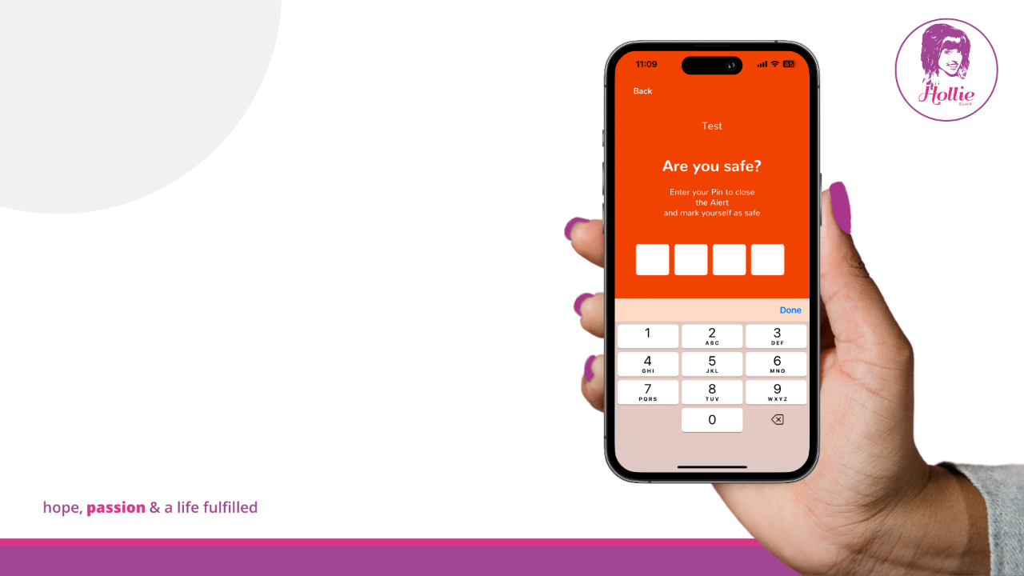
Cancelling an alert
You can cancel an Alert at any time by pressing ‘Tap Here To Cancel’.
You will be asked to answer yes or no to ‘Are you safe?’ and then enter your four-digit pin.
You’ll need to enter your four-digit pin when logging out of the app too.
Notes:
Cancel an alert – To cancel your Hollie Guard alert and to stop your evidence recording, you will simply need to enter your 4-digit PIN.
You will also use your 4-digit PIN to log in and out of the app so it will need to be in a memorable format.
We often recommend using your date of birth in the format DD/MM.

Slide 24

Duress Pin
In an emergency, you may be forced to cancel an alert by an attacker.
When cancelling the alert, you can type in ‘9999’ instead of your usual four-digit pin code to escalate and prioritise your Alert.
You can use ‘9999’ at any point, when asked for your pin, to escalate your Alert.
Notes:
Duress pin - In situations where the perpetrator may have noticed you’ve activated an alert and is forcing you to cancel it, the duress pin can provide reassurance.
When entering “9999” this will appear as though the app has logged you out however, this is not the case.
What will happen is that the emergency contacts will receive an additional message to advise that you have been forced to cancel the alert – location tracking and evidence will still be recorded from the device despite appearing to have logged out.

Slide 25
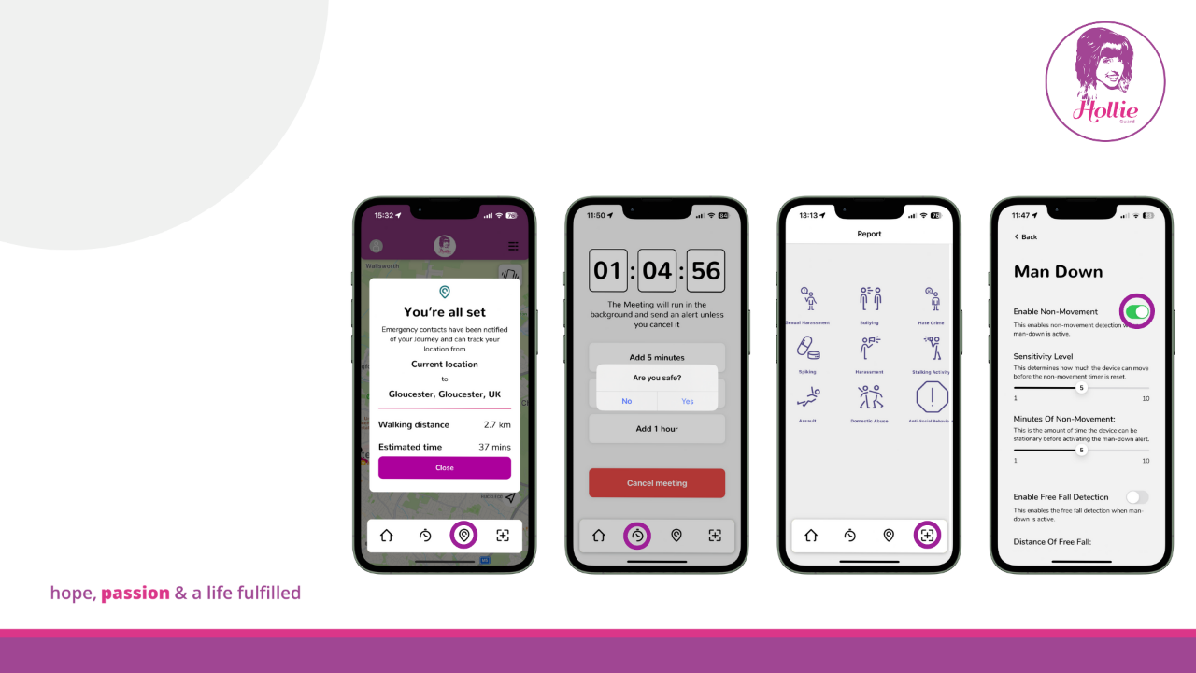
App Features
Hollie Guard has numerous features which can assist when completing day-to-day tasks:
Journey Feature
Meeting Feature
Reporting Feature
Accident Detection Feature

Slide 26
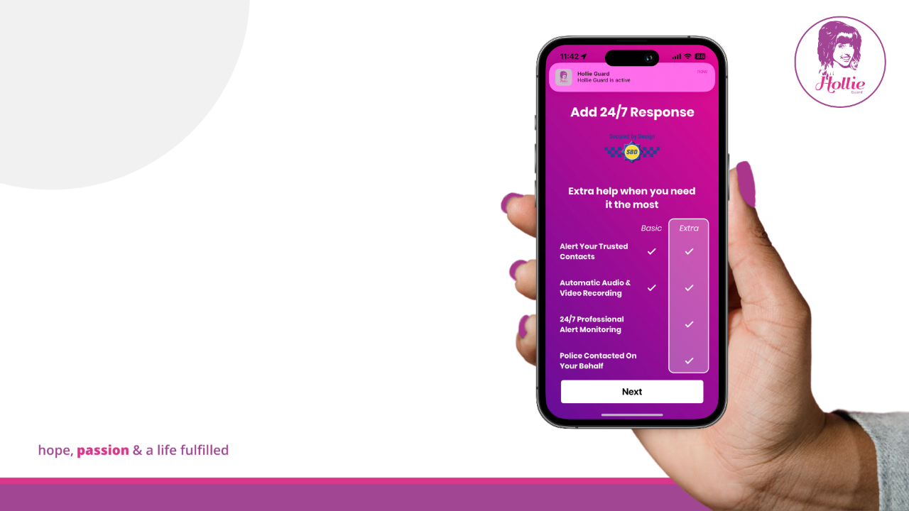
Hollie Guard Extra
Hollie Guard Extra provides an enhanced level of 24/7 professional alert monitoring.
Individuals can upgrade through the app on a monthly or annual basis.
Gift boxes can be purchased on our website.
+
All alerts raised on our Hollie Guard Extra subscription will be answered by our professional response team who will assess the situation. They will attempt to contact the individual whilst, alerting any nominated emergency contacts.
Notes:
Hollie Guard Extra – All the features and functionalities I’ve discussed so far are available on the basic version of Hollie Guard – this subscription is free of charge and anyone within the UK with a compatible smartphone can access it.
In addition to Hollie Guard, we offer Hollie Guard Extra.
By upgrading your subscription to Hollie Guard Extra, you will have the reassurance that all raised alerts will be sent to a professional 24/7 alert monitoring centre and your nominated emergency contacts.
You can upgrade to Hollie Guard Extra upon registration or within the app menu on a monthly or annual basis.
Annual subscriptions can also be purchased via Amazon on behalf of a loved one who may be on a work placement or starting University.

Slide 27

Success Stories
"The Hollie Guard app is incredible, even just the free version. But for me as a lone worker at night and travelling to my place of work late, the subscription is PRICELESS. I have my work device at work but extra safety is always worth it."
“I would advise anyone to have this app on their phone! it is great and just knowing what it can do gives me reassurance.“
Hollie Guard is an integral part of many people’s day-to-day life.
Not only can Hollie Guard provide reassurance for lone workers, but it can also help individuals and victims of crime to stay safe and record incidents.
"I work alone. It makes me feel safe. I have added this to my daughter's phones and I have shared this app with everyone I know. I think it is fantastic. I came across it by accident but I am glad I did. Thank you from the bottom of my heart. My girls are a little safer in this crazy world thanks to Hollie's app."
"Not only for children but it's a great app for people with disabilities and health issues. For me, when confusion sets in, I can get lost easily. This app will allow my husband and support workers to find me quickly. It may save my life one day."

Slide 28

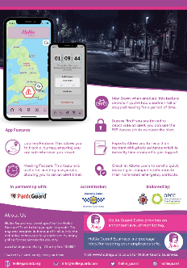

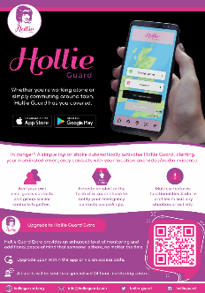






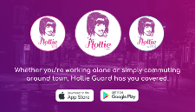


Resources & Accreditations
A5 leaflets
hollieguard.com
info@hollieguard.com
hollieguard
@Hollie_Guard
holliegazzardtrust
Business cards
Notes:
Resources and Accreditations – The Hollie Guard app has the accreditations shown on screen.
We provide literature to raise awareness of the application therefore, if these would be of interest you can get in touch with us via info@hollieguard.com and we can provide our A5 leaflets and business-sized cards.
In addition, if you or any of your clients require any support with the app or have any questions, you can direct them to the info@hollieguard.com email address where we can assist.
It would be great if you could follow our social media accounts, we have dedicated Hollie Guard pages on Twitter/X and Instagram where we share regular updates on the features and functionalities of Hollie Guard. Plus, if there are any app updates – this is how we will communicate with our users so, please give us a follow!

Slide 29

App Appearance
Hollie Guard users have the option to change the style of their app icon or to mask the app completely for discreet use.
For inconspicuous use, choose between the calculator or weather mask. This will update the app icon and if the app is opened, it will require the individual to disable the mask before opening Hollie Guard.
Default options include variations of the logo colour.
Notes:
App Appearance Default – We are continuously updating Hollie Guard following user feedback, the latest change we have implemented is the ability to change the app icon of Hollie Guard.
We have introduced default options which include variations of the logo and logo colour. This can be accessed via the app menu in the app appearance section.
App Appearance Mask Mode (20th slide) - In addition to the default options, there is also the ability to mask the Hollie Guard app with a working calculator or weather app for inconspicuous use. To reveal Hollie Guard, you will need to select one of the buttons within the calculator or weather app for a couple of seconds and it will uncover Hollie Guard for discreet use. There will be a tutorial on masking the app when you log in to Hollie Guard for the first time or via the app menu at any time.

Slide 30
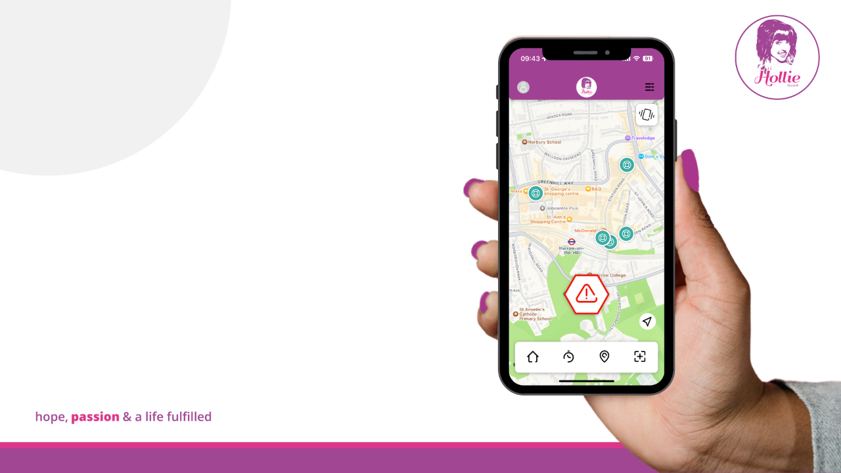


App Icons
App Icons
Through the Hollie Guard app, individuals can now locate premises that operate Ask for Angela and have the Licensing SAVI accreditation.
In premises that operate Ask for Angela, you can discreetly ask for help from a member of staff if you feel uncomfortable or are not safe.
Licensing SAVI is a police-backed security initiative for licensed premises to provide safer and more secure environments.

Slide 31
Thank you &
Questions
Notes:
To conclude, Hollie Guard is more than an app; it’s a source of reassurance and our hope is that one day no one will ever need to use it however, it is there for those situations where you may feel uncomfortable and need to capture any crucial evidence of an ongoing incident.
You can use Hollie Guard in both your personal life and professional life.
Thank you for your attention today, I welcome any questions you may have about the Trust or app….

